Slide 1
CS 463 Natural Language Processing
Dr. Saleh Haridy
2023-2024

Slide 2
Week 3
Minimum Edit Distance and Alignment

Slide 3
How to compute similarity between two strings?
Coreference: decide whether two strings refer to the same entity
Spell correction
The user typed “graffe”
Which is closest to?
giraffe
graf
graft
grail
MAjmaah President Dr.Saleh Almozal
Majmaah University Dr.Saleh Almozal
these two strings are very similar (differing by only one word
Also it is needed in Machine Translation, Information Extraction, Speech Recognition

Slide 4
Edit Distance
The minimum edit distance between two strings
Is the minimum number of editing operations
Insertion
Deletion
Substitution
Needed to transform one into the other

Slide 5
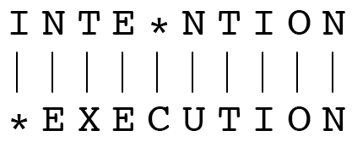
Minimum Edit Distance- example
Two strings and their alignment:

Slide 6
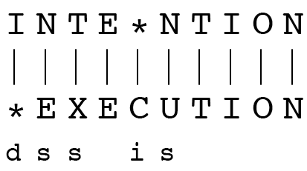
Minimum Edit Distance
How to align two strings?
Alignment is a correspondence between substrings of the two sequences
If each operation has cost of 1
Distance between these is 5
If substitutions cost 2 (Levenshtein)
Distance between them is 8
d for deletion, s for substitution, i for insertion.

Slide 7
Alignment in Computational Biology
Given a sequence of bases
An alignment:
Given two sequences, align each letter to a letter or gap
AGGCTATCACCTGACCTCCAGGCCGATGCCC
TAGCTATCACGACCGCGGTCGATTTGCCCGAC
-AGGCTATCACCTGACCTCCAGGCCGA--TGCCC---
TAG-CTATCAC--GACCGC--GGTCGATTTGCCCGAC

Slide 8
Other uses of Edit Distance in NLP
Evaluating Machine Translation and speech recognition
Spokesman confirms senior government adviser was appointed
Spokesman said the senior adviser was appointed
S I D
Named Entity Extraction and Entity Coreference
IBM Inc. announced today
IBM profits
Stanford Professor Jennifer Eberhardt announced yesterday
for Professor Eberhardt…

Slide 9
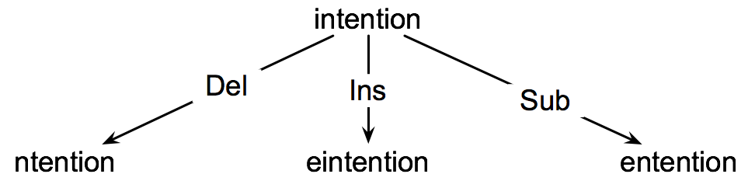
How to find the Min Edit Distance?
Searching for a path (sequence of edits) from the start string to the final string:
Initial state: the word we’re transforming
Operators: insert, delete, substitute
Goal state: the word we’re trying to get to
Path cost: what we want to minimize: the number of edits
Intention
execution

Slide 10
Minimum Edit as Search
But the space of all edit sequences is huge!
We can’t afford to navigate naïvely
Lots of distinct paths wind up at the same state.
We don’t have to keep track of all of them
Just the shortest path to each of those revisited states.
We can do this by using dynamic programming.
Dynamic programming apply a table-driven method to solve problems by combining solutions to sub-problems.

Slide 11
Defining Min Edit Distance
For two strings
X of length n
Y of length m
We define D(i,j)
the edit distance between X[1..i] and Y[1..j]
i.e., the first i characters of X and the first j characters of Y
The edit distance between X and Y is thus D(n,m)

Slide 12

Dynamic Programming for Minimum Edit Distance
Dynamic programming: A tabular computation of D(n,m)
Solving problems by combining solutions to subproblems.
Bottom-up
We compute D(i,j) for small i,j
And compute larger D(i,j) based on previously computed smaller values
i.e., compute D(i,j) for all i (0 < i < n) and j (0 < j < m)

Slide 13
Defining Min Edit Distance (Levenshtein)
Initialization
D(i,0) = i
D(0,j) = j
Recurrence Relation:
For each i = 1…M
For each j = 1…N
D(i-1,j) + 1
D(i,j)= min D(i,j-1) + 1
D(i-1,j-1) + 2; if X(i) ≠ Y(j)
0; if X(i) = Y(j)
Termination:
D(N,M) is distance

Slide 14
Min Edit Distance

Slide 15
The Edit Distance Table
target
 | # | E | X | E | C | U | T | I | O | N
# | 0 | 1 | 2 | 3 | 4 | 5 | 6 | 7 | 8 | 9
I | 1
N | 2
T | 3
E | 4
N | 5
T | 6
I | 7
O | 8
N | 9
Source

Slide 16
The Edit Distance Table

Slide 17
Computing alignments
Edit distance isn’t sufficient
We often need to align each character of the two strings to each other
We do this by keeping a “backtrace”
Every time we enter a cell, remember where we came from
When we reach the end,
Trace back the path from the upper right corner to read off the alignment

Slide 18
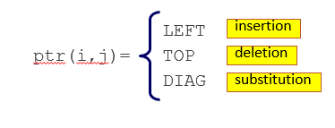
MinEdit with Backtrace

Slide 19
Adding Backtrace to Minimum Edit Distance
Base conditions: Termination:
D(i,0) = i D(0,j) = j D(N,M) is distance
Recurrence Relation:
For each i = 1…M
For each j = 1…N
D(i-1,j) + 1
D(i,j)= min D(i,j-1) + 1
D(i-1,j-1) + 2; if X(i) ≠ Y(j)
0; if X(i) = Y(j)
LEFT
ptr(i,j)= TOP
DIAG
deletion
insertion
substitution
insertion
deletion
substitution

Slide 20
The Distance Matrix
Every non-decreasing path
from (0,0) to (M, N)
corresponds to
an alignment
of the two sequences
x₀ …………………… x_{N}
An optimal alignment is composed of optimal subalignments
y₀ ……………………………… y_{M}

Slide 21
Result of Backtrace
Two strings and their alignment:

Slide 22
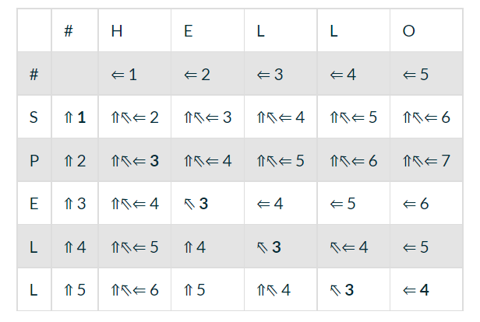
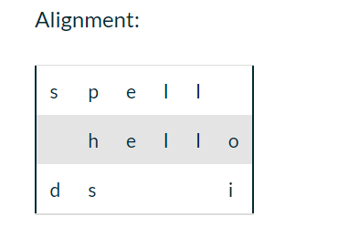
Example 2

Slide 23
Performance
Time:
O(nm)
Space:
O(nm)
Backtrace
O(n+m)

Slide 24
Minimum Distance implementation in python
https://giov.dev/2016/01/minimum-edit-distance-in-python.html

